Slide 1
Therapeutic Jurisprudence
NQLA Conference Cairns, 2023

Slide 2
The Song…

Slide 3
THERAPUTIC the branch of medicine concerned with the treatment of disease and the action of remedial agents. JURISPRUDENCE derives from the Latin term juris prudentia, which means "the study, knowledge, or science of law

Slide 4
T J

Slide 5
Drug Court

Slide 13
Brisbane
Sydney
Melbourne
Adelaide
Canberra
Auckland
New York
Prague
Vienna

Slide 14
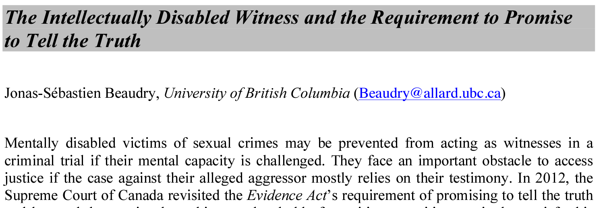
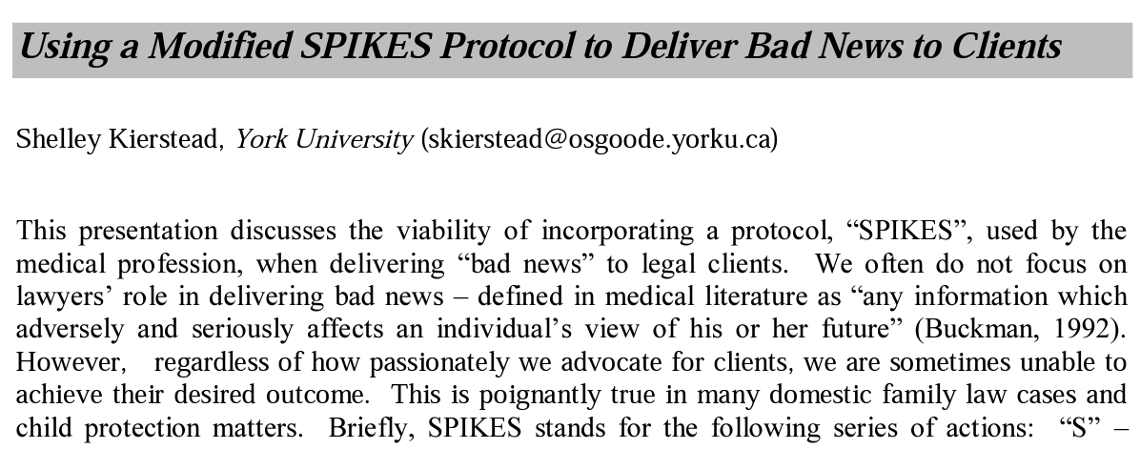

Slide 17
Refugees
Researching TJ
Restorative justice
Sentencing
Sexual assault
TJ articles
TJ events
TJ for Lawyers
TJ for teachers
TJ for the Judiciary
TJ in action
TJ Lawyering Series
Wills & estates
Wine & Bottles
Worldwide TJ community news
Youth/juvenile justice
Alcohol and other drugs
Alternative Dispute Resolution
Amicus Justitia briefs
Books about TJ
Child protection
Civil law
Court Support
Courts
Criminal Justice
Cyber law
Domestic/family violence
Elder law
Environmental law
Evidence informed practice
Family law
Guardianship & administration
Housing & tenancy
Housing & tenancy
Indian Chapter ISTJ
Indigenous
Introduction to TJ
Journals & books on TJ
Judges
Judiciary
Judiciary Court Craft Series
Lawyers
Legal education
Mainstreaming TJ
Mental health
Offender supervision
Property & planning
Prosecutors
Public policy
Refugees

Slide 20
Therapeutic Jurisprudence Practice in Courts
Person Centred
Procedurally Fair
Programs are designed with the needs and lived experience of participants at the centre. Lawyers support their clients to make their own decisions
Legal actors – judiciary, lawyers, prosecutors, court staff - give voice to participants, show respect, build trust through an ethic of care, ensure participants understand processes & decisions and try to be helpful
Inclusive
Legal actors - Understand & are respectful of First Nations culture / Recognise, respect & support people with lived experience of disability / Understand & are respectful of Diversity
Solution-Focused
Legal actors motivate engagement & behavioral change to improve wellbeing of people & communities / Value dignity, agency & self-determination of participants / Use active listening, dialogue & other evidence-based tools & techniques / Work in a multi-disciplinary way with non-legal supports
Therapeutic Jurisprudence practice in courts respects the law and due process
and is….
Respectful of human rights
Human dignity is upheld through the application of human rights principles
Compassionate
Trauma informed
Legal actors endeavour to understand
& alleviate challenges faced by court participants / A compassionate approach also supports the wellbeing of legal actors
Legal actors - Understand the impacts of trauma /
Practice consistency, trustworthiness, choice, collaboration, empowerment /
Understand ‘difficult’ behaviour as maybe
a coping or self-protection mechanism;
Take a strengths-based approach
Evolving
TJ is interdisciplinary. TJ practices are drawn from other relevant disciplines. As knowledge evolves in other disciplines it can be translated into new TJ practices.
A resource of the International Society for TJ www.intltj.com For links to further resources see: www.mainstreamtj.wordpress.com/tj-in-courts/

Slide 21
Procedural Fairness

Slide 22
Solution-Focused

Slide 23
Trauma-Informed

Slide 24
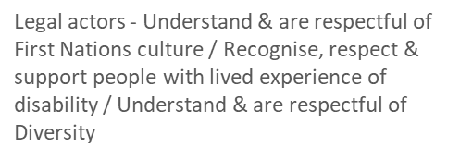
Inclusive

